Slide 1
Molecular Genetics Laboratory
BT 344
Chi-Square Analysis
MBL. BT453

Slide 2

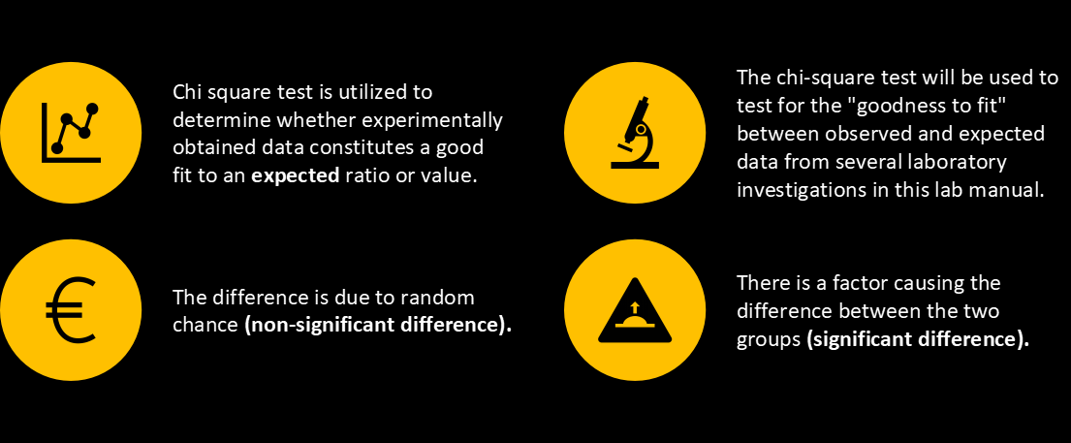
Chi- square

Slide 3
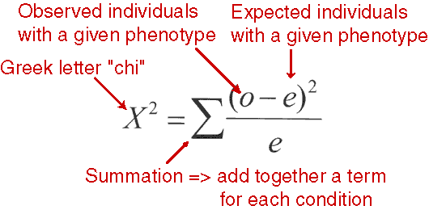
Chi Squared Analysis
Determines if data is “good”
FORMULA: X² = Σ (O – E)²
E
O: observed values
E: expected values

Slide 4
Chi Squared Null Hypotheses
Null Hypothesis: there is no significant difference between the expected and observed result
  If accepted, you are claiming that mating is random and so is segregation and independent assortment
  P Value is greater than 0.05
Reject Null Hypothesis:
  you are seeing that the deviation between observed and expected is very far apart…something non-random must be occurring….
  P Value is less than 0.05

Slide 5
Degrees of Freedom
Must determine the degrees of freedom
Degrees of freedom: # of phenotypic possibilities in your cross minus 1
Degrees of freedom (df) = n-1
n is generally described as the number of values that are allowed to vary freely.

Slide 6
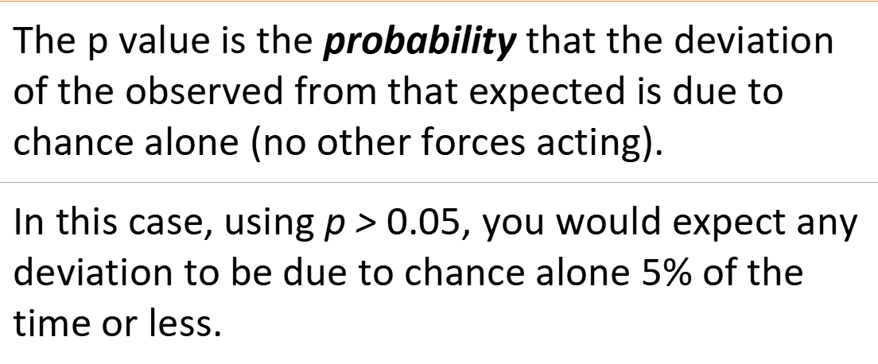
Chi- square

Slide 7
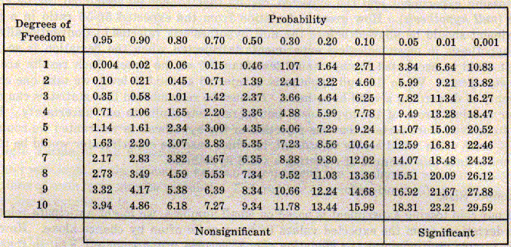

Slide 8
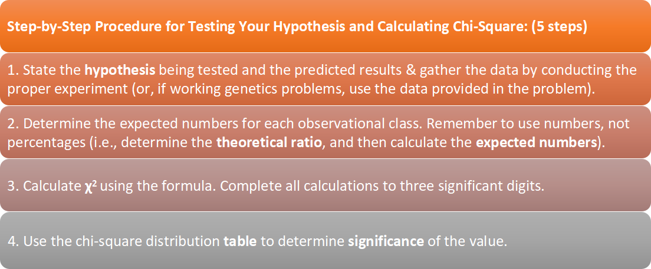
Chi- square

Slide 9
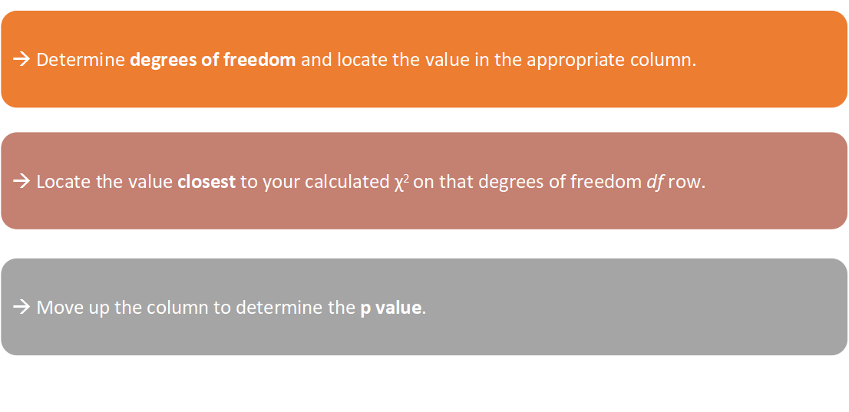
Chi- square

Slide 10
→ If the p value for the calculated χ² is p > 0.05, accept your hypothesis. 'The deviation is small enough that chance alone accounts for it. A p value of 0.6, for example, means that there is a 60% probability that any deviation from expected is due to chance only. This is within the range of acceptable deviation.
→ If the p value for the calculated χ2 is p < 0.05, reject your hypothesis, and conclude that some factor other than chance is operating for the deviation to be so great. For example, a p value of 0.01 means that there is only a 1% chance that this deviation is due to chance alone. Therefore, other factors must be involved.

Slide 11
Example #1
If you toss a coin, there is 1:1 probability to get heads or tails. If you toss a coin 20 times, and get 8 heads and 12 tails, do your results significantly differ from the expected results or not?
 | observed | Expected
Head | 8 | 10
Tail | 12 | 10

Slide 12
Example #1
1- Put null and alternative hypotheses:
→ Null hypothesis (your hypothesis): There is no significant difference between the observed and expected results.
Alternative hypothesis: There is a significant difference between the observed and expected results.
2- Choose a cut-off P-value.
After finishing your Chi square test, you will end up with a number. The number you will get is the probability of the difference between the two groups being due to chance. But how can you determine if the number is low or high? To do this, before testing our hypothesis, we determine a P-value; which can be 0.01, 0.05 or 0.1. We will compare our result with this cut-off value.
For our example, lets choose P=0.05

Slide 13
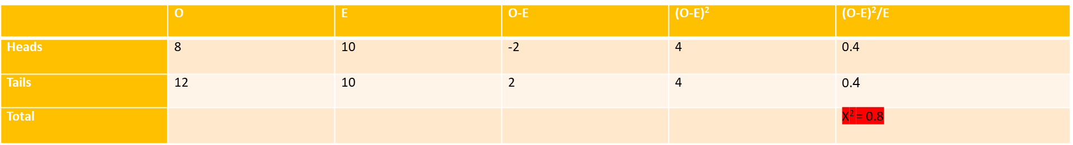
Example #1
3- Test your hypothesis!
3.1 Calculate Chi (X²):
X²= Σ (Observed - Expected)²
-------------------------------
Expected

Slide 14
Example #1
3.2 Calculate the degrees of freedom:
→ Df = number of categories - 1
In our example, there are two categories; heads and tails, so:
→ Df= 2 – 1 = 1
From the table, first determine the horizontal line that has your degrees of freedom, and from that line choose the value closest to your X² value. In this case the value is 0.455. From the title of the vertical line that contains this value, we can determine the P-value.
The P-value= 0. 5, which means that the difference between the observed and expected results are 50% due to chance.

Slide 15
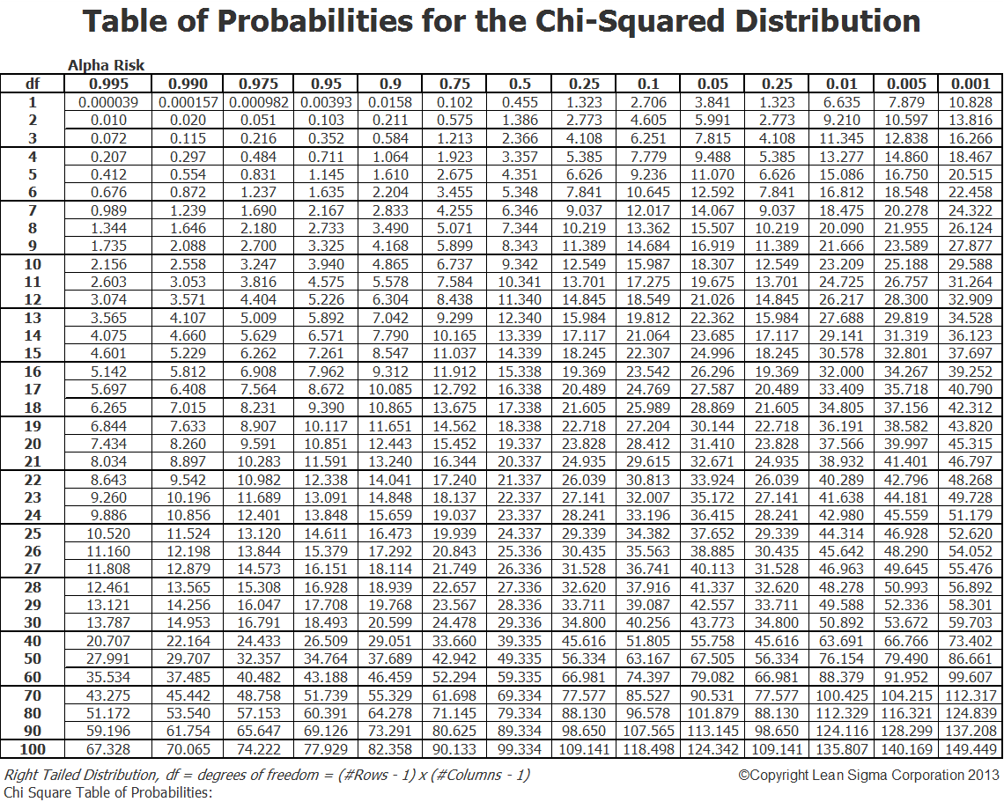

Slide 16
Example #1
4. State your conclusion in terms of your hypothesis.
The final P-value we obtained is more than 0.05, so we say:
P > 0.05
We accept our null hypothesis, and we can now say that the difference between the observed and expected results is not significant. And from our data, we can reject the alternative hypothesis.

Slide 17
Example #2
For the curly wing phenotype, you did a cross between a female wildtype homozygous and male curly heterozygous, and from 95 flies you got the following phenotypes :
 | Curly | wildtype | Total
Male | 17 | 23 | 40
Female | 25 | 20 | 45

Slide 18
Example #2
Does this trait follow Mendel's law of segregation?
1- State the null and alternative hypotheses.
Null hypothesis: Curly wing trait follows mendel’s law segregation, and there is no significant difference between the observed and expected results.
Alternative hypothesis: Curly wing trait does not follow mendel’s law segregation, and there is a significant difference between the observed and expected results.
2- Choose a cut-off P-value
→ P = 0.05

Slide 19
Example #2
3- Test your hypothesis.
3.1 Calculate the expected phenotype if the trait follows Mendel’s law of segregation.
Mendel’s law of segregation states that upon gamete formation, for each gene, each gamete gets one allele only.
So, if we know that the mutation for curly wings (Cy) in Drosophila is autosomal dominant, and we perform the following cross:
P1: Female Cy⁺Cy⁺ x Male Cy⁺Cy
F1 genotypes: Cy⁺Cy⁺ , Cy⁺Cy

Slide 20
Example #2
If mendel’s law is correct, the female gametes will contain a (Cy+) allele each, and for the male gametes; some will contain one (Cy) allele and some will contain one (Cy+) allele. If we represent the cross by Punnett square it will be as follows:
 | Cy+ | Cy+
Cy | Cy+Cy | Cy+Cy
Cy+ | Cy+Cy+ | Cy+Cy+

Slide 21
Example #2
From the Punnett square, we can see the phenotypic ration is:
→ 1 Curly : 1 Wildtype
For the 40 males, the expected number of:
Wildtype flies= 40x ½ = 20
Curly flies= 40 x ½ = 20
For the 45 females, the expected number of:
Wildtype flies= 45x ½ = 22.5
Curly flies= 45 x ½ = 22.5

Slide 22
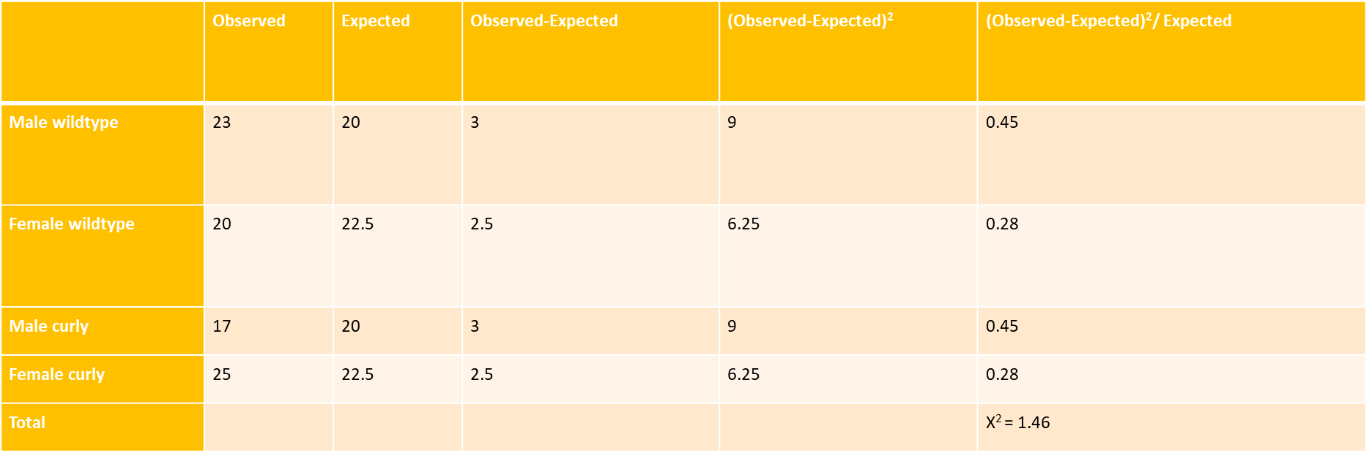
Example #2
3.2 Calculate X²
X²= Σ (Observed-Expected)² Expected

Slide 23
Example #2
3.3 Calculate the degrees of freedom
Df=4-1=3
The P-value= 0.75, which means that the difference between the observed and expected phenotypes is 75% due to chance, and 25% due to other factors.
4. State your conclusion in terms of your hypothesis.
P > 0.05
We accept our null hypothesis. There is no significant difference between the observed and expected results, and this means that the curly wings phenotype follows Mendel’s law of segregation.

Slide 25
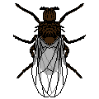
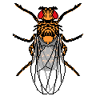

Let’s look at a fruit fly cross
Example #3
x
P: Black body, eyeless
wild
F1: all wild

Slide 26
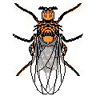
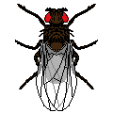

F1 x F1
5610
1881
622
1896

Slide 27
Results Analysis
1. Determine the cross that you were using
  Dihybrid Complete Dominance
2. What is the expected outcome of this cross?
  9/16 wild type (yellow body, eyes)
  3/16 normal body eyeless (yellow body, no eyes)
  3/16 black body wild eyes (black body, no eyes)
  1/16 black body eyeless (black body, eyes)

Slide 28
3. Conduct the Analysis: Create a perfect, “expected” 9:3:3:1 ratio
A. Divide total individuals by 16
10009/16 = 626
B. Multiply by perfect ratio#
626*9= 5,634 for 2 domain loci (wild type)
Phenotype | Observed | Expected
Wild | 5,610 | 5,634 (=626*9)
Eyeless | 1,881 | 1,878 (=626*3)
Black Body | 1,896 | 1,878 (=626*3)
Eyeless, Black Body | 622 | 626 (=626*1)
TOTAL | 10,009

Slide 29

4. Apply the Chi Squared formula to each phenotype:
    (5610 - 5630)²/ 5630 = 0.07
    (1881 - 1877)²/ 1877 = 0.01
    (1896 - 1877 )²/ 1877 = 0.20
    (622 - 626) ²/ 626 = 0.02
χ ²= .30
5. Determine Degrees of Freedom = # of phenotypes – 1
4-1= 3
6. Find the value closest to chi squared on Chi Squared Distribution Table, ex. 0.35

Slide 30
6. Conclude Chi Squared Analysis
“With 3 degrees of freedom, my chi squared value is 0.35, which gives a P value of 95%, therefore I accept my null hypothesis. “
  This means that 95% of the time when our observed data is this close to our expected data, this deviation is due to random chance.
  P value is greater than 0.05, therefore accept our null hypothesis

Slide 31

There are several genes controled the kernels appearance in corn ear.
Dominant Genes | Recessive Genes
P = Purple | p = Yellow
S = Smooth | s = Shrunken

Slide 32
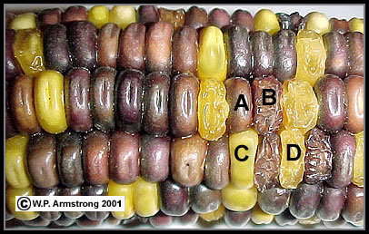
There are four grain phenotypes in this ear of genetic corn:
(A): Purple & Smooth
(B): Purple & Shrunken
(C): Yellow & Smooth
(D): Yellow & Shrunken.
These four grain phenotypes are produced by the following two pairs of heterozygous genes (P & p and S & s) located on two pairs of homologous chromosomes (each gene on a separate chromosome):

Slide 33
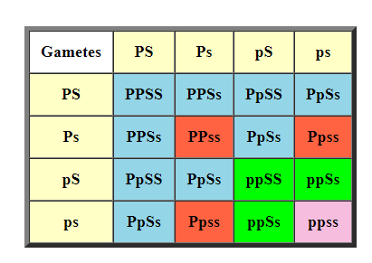
The following Table 1 shows a dihybrid cross between two heterozygous parents (PpSs X PpSs).

Slide 34
Chi Square Problem:
An ear of corn has a total of 381 grains, including 216 Purple & Smooth, 79 Purple & Shrunken, 65 Yellow & Smooth, and 21 Yellow & Shrunken. These phenotypes and numbers are entered in Columns 1 and 2 of the following Table 2.

Slide 35
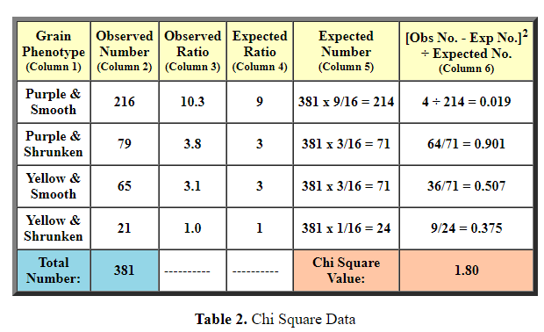
The Hypothesis: This ear of corn was produced by a dihybrid cross (PpSs x PpSs) involving two pairs of heterozygous genes resulting in a theoretical (expected) ratio of 9:3:3:1. See dihybrid cross in Table 1.

Slide 36
Degrees Of Freedom: Number of phenotypes - 1.
In this problem the number of phenotypes is four; therefore, the degrees of freedom (df) is three
(4 - 1 = 3).
Probability Value: In the following Table 3, find the number in row three that is closest to your chi square value of 1.80. In this table 1.85 (shaded in yellow) is the closest number.
Then go to the top of the column and locate your probability value. In this case the probability value that lines up with 1.85 is .60.

